Slide 1
Universität Heidelberg

Slide 2
„Shanghai“-Ranking
World Rank | Institution | Total Score | Score on Alumni | Score on Award | Score on HiCi | Score on N&S | Score on SCI | Score on Size
1 | Harvard | 100.0 | 98.6 | 100.0 | 100.0 | 100.0 | 100.0 | 60.6
2 | Stanford | 77.2 | 41.2 | 72.2 | 96.1 | 75.2 | 72.3 | 68.1
3 | Cambridge | 76.2 | 100.0 | 93.4 | 56.6 | 58.5 | 70.2 | 73.2
4 | UC Berkeley | 74.2 | 70.0 | 76.0 | 74.1 | 75.6 | 72.7 | 45.1
5 | MIT | 72.4 | 74.1 | 78.9 | 73.6 | 69.1 | 64.6 | 47.5
45 | TU München | 33.3 | 43.1 | 24.1 | 27.6 | 20.4 | 50.0 | 32.0
51 | LMU München | 32.4 | 37.2 | 21.1 | 12.4 | 32.0 | 56.0 | 31.1
57 | Uni Zürich | 31.1 | 12.6 | 27.3 | 21.4 | 30.3 | 48.9 | 29.9
59 | Uni Kopenhagen | 31.0 | 30.8 | 24.7 | 23.1 | 22.6 | 48.1 | 29.8
64 | Uni Heidelberg | 29.7 | 10.9 | 27.7 | 23.1 | 22.1 | 49.7 | 28.5

Slide 3
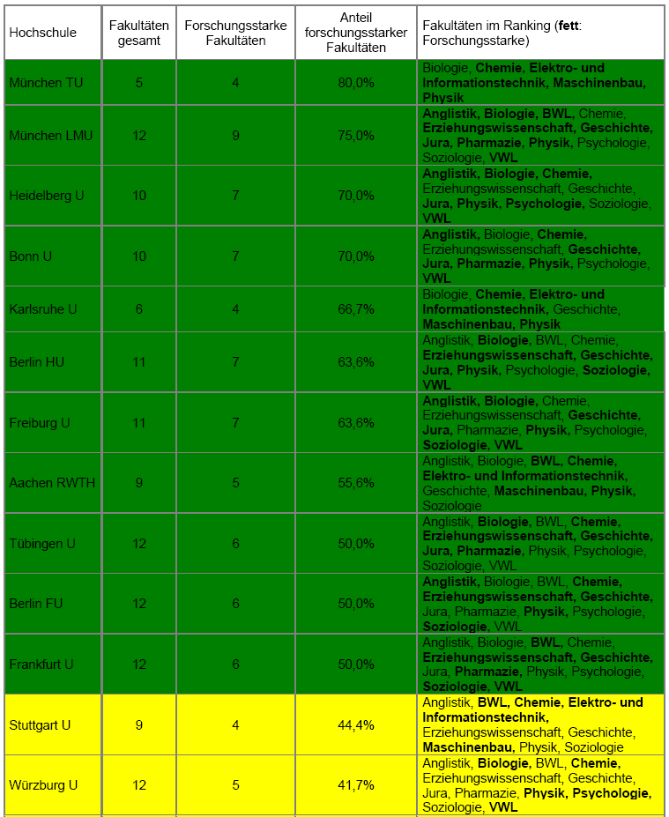
Forschungsuniversitäten 2004

Slide 4
Plätze...

Slide 5
Plätze...

Slide 6
Indikatoren des ‚Shanghai-Ranking‘
Criteria | Indicator | Code | Weight
Quality of Education | Alumni of an institution winning Nobel Prizes and Fields Medals | Alumni | 10%
Quality of Faculty | Staff of an institution winning Nobel Prizes and Fields Medals | Award | 20%
 | Highly cited researchers in 21 broad subject categories | HiCi | 20%
Research Output | Articles published in Nature and Science* | N&S | 20%
 | Articles in Science Citation Index-expanded and Social Science Citation Index | SCI | 20%
Size of Institution | Academic performance with respect to the size of an institution | Size | 10%
* For institutions specialized in humanities and social sciences such as London School of Economics, N&S is not considered, and the weight of N&S is relocated to other indicators.

Slide 7
CHE - Forschung
Drittmittel
Publikationen
Forschungsdaten
Zitationen
Promotionen
Patente
relativ (pro-Kopf)
gehen zweifach ein:
absolut
Notes:
Verwendung der Daten im Forschungsranking

Slide 8
Alle Rankings sind ...
... ungerecht!
Shanghai
CHE
Nobelpreise
Fächerperspektive
naturwissenschaftlich
50 % Grenze
englischsprachige
Kulturwissenschaft
Besonderheiten
Notes:
Verwendung der Daten im Forschungsranking

Slide 9
fair, informativ, qualifiziert

Slide 10
„The system used by CHE to evaluate universities is probably the best model available today in the world of higher education.“
Prof. Dr. Francois Tavenas
Rector Emeritus of Université Laval (Quebec)
Founding Rector of Université de Luxembourg
Quality Assurance: A Reference System for Indicators and Evaluation Procedures, Brüssel April 2004

Slide 11
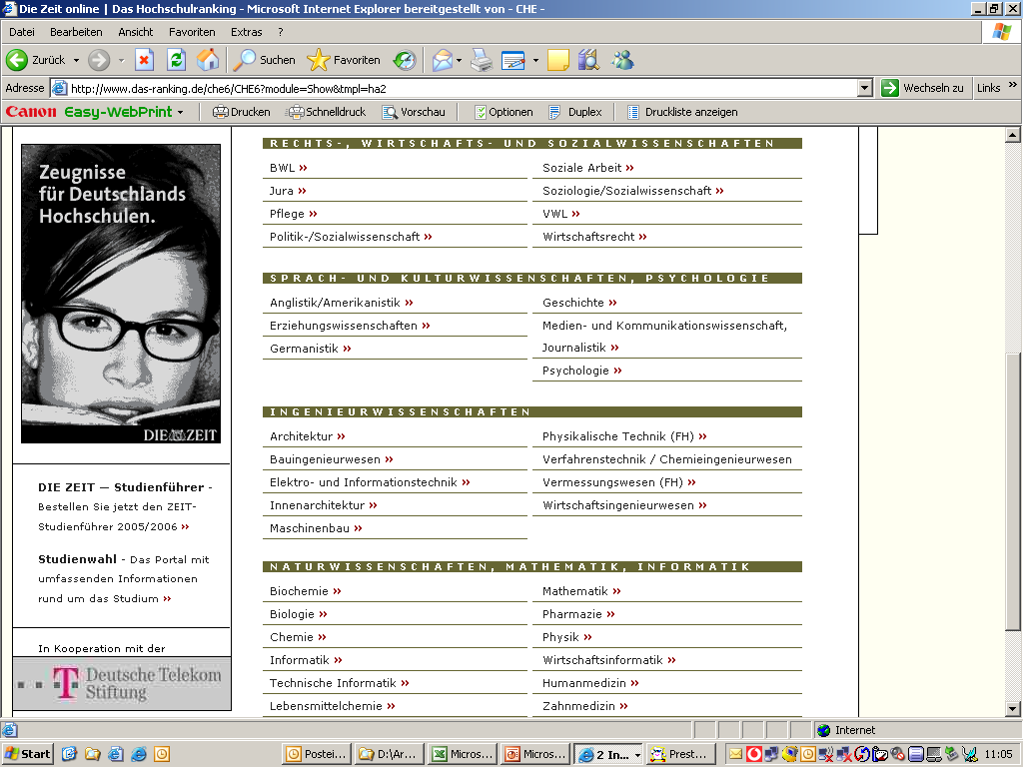
5 Besonderheiten
Nr. 1
Fächer-
vergleiche

Slide 12
1. Zyklus
2. Zyklus
3. Zyklus
1998
Wirtschaft,
Chemie
2002
Wirtschaft, Jura
Sozialwiss.
2005
Wirtschaft, Jura
Sozialwiss.
260 Hochschulen
4.000 Studienangebote
175.000 Einzeldaten
alle drei Jahre aktualisiert
36 Studienbereiche
1999
Jura,
Naturwiss.
2003
Naturwiss.,
Medizin
2006
Naturwiss.,
Medizin
2000
Ingenieurwiss.
2004
Ingenieur-,
Geisteswiss..
2007
Ingenieur-,
Geisteswiss..
75 % Studierende
2001
Geisteswiss..

Slide 13
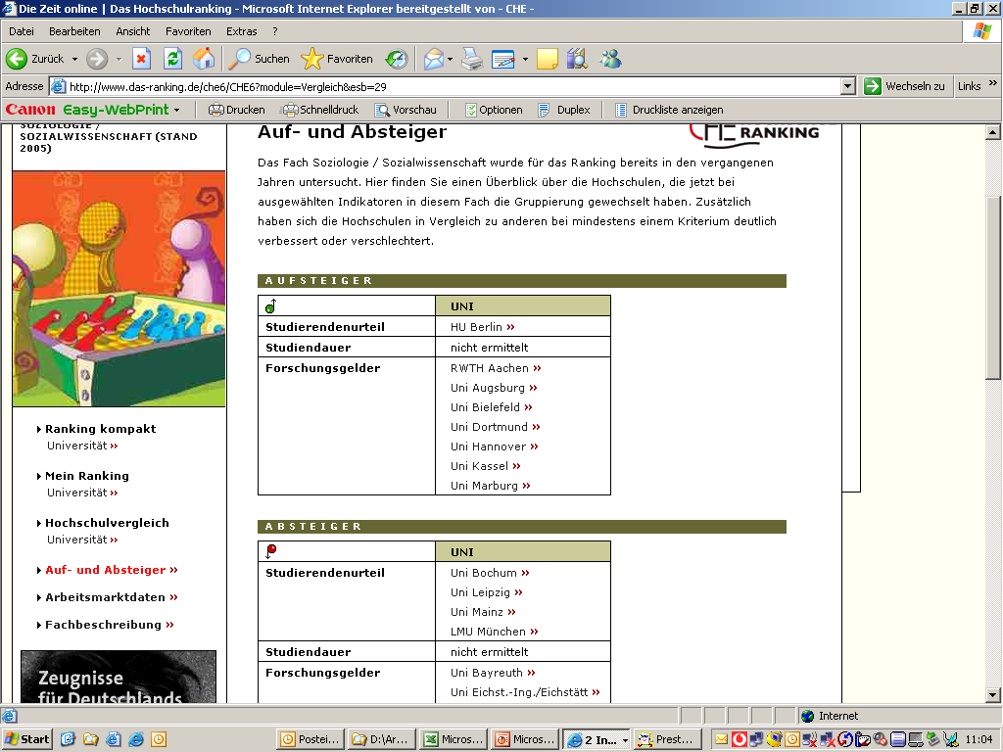
5 Besonderheiten
Nr. 2
Wieder-
holungen
mit
Zeit-
vergleich

Slide 14
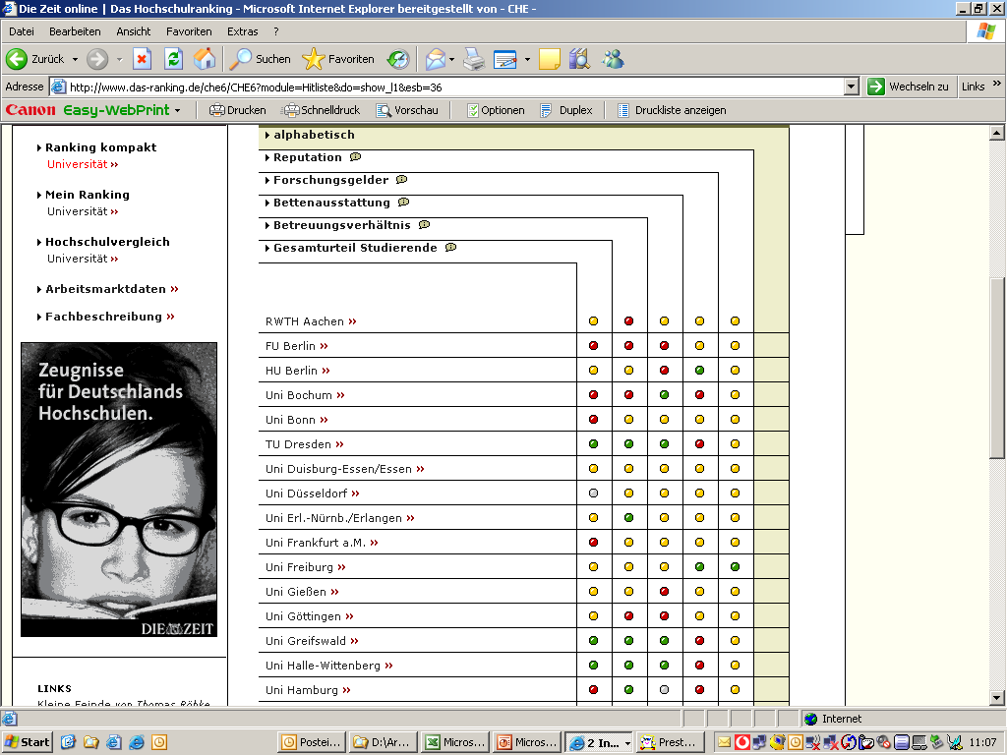
5 Besonderheiten
Spitze
Mittel
Schluss
Nr. 3
keine
Rang-
plätze
nur
Rang-
gruppen

Slide 15
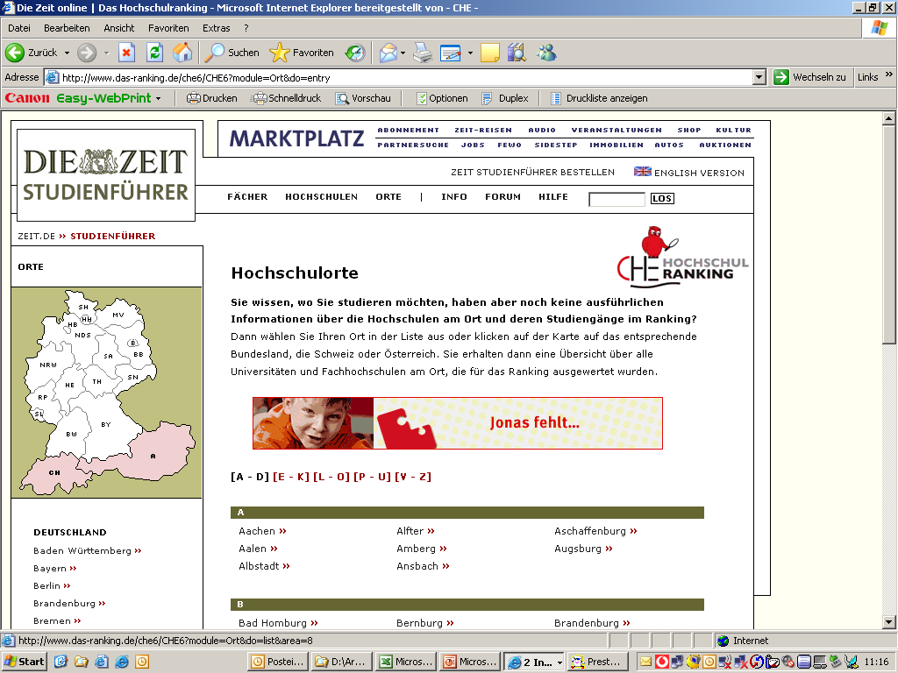
5 Besonderheiten
Nr. 4
inter-
national

Slide 16
5 Besonderheiten
Mein Ranking
Nr. 5
keine (gewichteten) Gesamtwerte,
sondern
multidimensionales Ranking

Slide 17
My Ranking - example
1st step: selection of indicators

Slide 18
My Ranking - example
2nd step: relevance of indicators

Slide 19
My Ranking - example
... and the result:

Slide 20
My Ranking - example
... which would be different with different indicators:

Slide 22
Physik: Drittmittel
25% Hochschulen
50% Drittmittel
25% Hochschulen
10% Drittmittel

Slide 23
Forschungsstarke Fakultäten
Physik

Slide 24
Forschungsuniversität
Forschungsuniversität
50%
Forschungs-starke Fakultät
Forschungs-starke Fakultät
Forschungs-starke Fakultät
…
…
50%
50%
50%
Indikator
Spitzengruppe
Indikator
Spitzengruppe
Indikator
Spitzengruppe
Indikator
Spitzengruppe
…
…
…

Slide 25
Ranggruppenverfahren
Mittelwert Uni 1
Mittelwert Uni 4
Gesamtmittelwert
Mittelwert Uni 2
Mittelwert Uni 3

Slide 26
Gesamturteil Jura 2005
2,4

Slide 27
Physik: Drittmittel in t€ pro Jahr
25% Hochschulen
50% Drittmittel
gültig für alle Fächer
gültig für alle Indikatoren
25% Hochschulen
10% Drittmittel

Slide 28
Drittmittelherkunft (Psychologie)

Slide 29
Humboldt`sches Ideal (BWL, Publikationen)
Lehre
Forschung

Slide 30
VWL nationale/internatonale Publikationen

Slide 31
Europäische Hochschulen im ‚Shanghai-Ranking‘
Regional Rank | Institution* | Country | World Rank
1 | Univ Cambridge | UK | 3
2 | Univ Oxford | UK | 8
3 | Imperial Coll London | UK | 23
4 | Univ Coll London | UK | 25
5 | ETH Zürich | Switzerland | 27
6 | Univ Utrecht | Netherlands | 39
7 | Univ Paris 06 | France | 41
8 | Tech Univ Munich | Germany | 45
9 | Karolinska Inst Stockholm | Sweden | 46
10 | Univ Edinburgh | UK | 47
11 | Univ Paris 11 | France | 48
12 | Univ Munich | Germany | 51
13 | Univ Zürich | Switzerland | 57
14 | Univ Copenhagen | Denmark | 59
15 | Univ Bristol | UK | 60
16 | Univ Leiden | Netherlands | 63
17 | Univ Heidelberg | Germany | 64
18 | Moscow State | Russia | 66
19 | Univ Oslo | Norway | 68
20 | Univ Sheffield | UK | 69

Slide 32
Indikatoren des ‚Shanghai-Ranking‘
2. Definition of Indicators Alumni. The total number of the alumni of an institution winning Nobel Prizes and Fields Medals. Alumni are defined as those who obtain bachelor, Master's or doctoral degrees from the institution. Different weights are set according to the periods of obtaining degrees. The weight is 100% for alumni obtaining degrees in 1991-2000, 90% for alumni obtaining degrees in 1981-1990, […] and so on, and finally 10% for alumni obtaining degrees in 1901-1910. […] Award. The total number of the staff of an institution winning Nobel prizes in physics, chemistry, medicine and economics and Fields Medal in Mathematics. Staff is defined as those who work at an institution at the time of winning the prize. Different weights are set according to the periods of winning the prizes. […] If a winner is affiliated with more than one institution, each institution is assigned the reciprocal of the number of institutions. For Nobel prizes, if a prize is shared by more than one person, weights are set for winners according to their proportion of the prize.
HiCi. The number of highly cited researchers in 21 broad subject categories in life sciences, medicine, physical sciences, engineering and social sciences. These individuals are the most highly cited within each category for the period of 1981-1999. […]

Slide 33
Indikatoren des ‚Shanghai-Ranking‘
The number of articles published in Nature and Science between 1999 and 2003. To distinguish the order of author affiliation, a weight of 100% is assigned for corresponding author affiliation, 50% for first author affiliation (second author affiliation if the first author affiliation is the same as corresponding author affiliation), 25% for the next author affiliation, and 10% for other author affiliations. Only publications of article type are considered. SCI. Total number of articles indexed in Science Citation Index-expanded and Social Science Citation Index in 2003. Only publications of article type are considered. Size. The total scores of the above five indicators divided by the number of full-time equivalent academic staff. If the number of academic staff for institutions of a country cannot be obtained, the total scores of the above five indicators is used. For ranking - 2004, the number of full-time equivalent academic staff are obtained for institutions in USA, China (mainland), Italy, Netherlands, Sweden, and Belgium etc.
http://ed.sjtu.edu.cn/rank/2004/Methodology.htm

Slide 34
Drittmittel: DFG - CHE
Fächergruppen DFG | Korrelation zwischen DFG- und CHE-Daten
Mathematik | 0,94
Medizin | 0,93
Physik | 0,87
Chemie/Lebensmittelchemie/Biochemie/Pharmazie | 0,79
Biologie | 0,57

