Slide 1
CHE-Ranking Methodology and Results
Prof. Dr. Detlef Müller-Böling
Gero Federkeil
CHE Center for Higher Education Development
Germany
University Ranking Systems as Information Tools
and Instruments for Assessing Institutional Strength
24. November, Bucharest

Slide 2
Initiated by German Rectors‘ Conference
early 90s
Founding task for CHE

Slide 3
„The system used by CHE to evaluate universities is probably the best model available today in the world of higher education.“
Prof. Dr. Francois Tavenas
Rector Emeritus of Université Laval (Quebec)
Founding Rector of Université de Luxembourg
Quality Assurance: A Reference System for Indicators and Evaluation Procedures, Brüssel April 2004

Slide 4
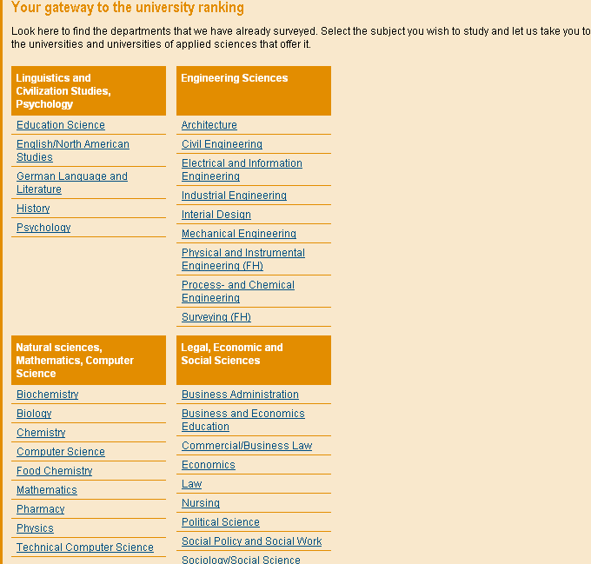
5 unique selling points
No 1
comparison
of
disciplines

Slide 5
1st cycle
2nd cycle
3rd cycle
260 universities
4.000 degree programs
175.000 single data
1998
business,
chemistry
2002
business, law,
soc. sciences
2005
business, law,
soc. sciences
35 disciplines
1999
law,
sciences.
2003
sciences,
medicine
2006
sciences,
medicine
more than 75 % of all students
2000
engineering.
2004
engeneering,
humanities
2007
engineering,
humanities
2001
humanities

Slide 6
5 unique selling points
No 2
time
series

Slide 7
5 unique selling points
No 3
no
league
table
but
rank
groups
top
medium
bottom

Slide 8
5 unique selling points
No 4
no overall
score
but
mulit-
dimensional
ranking

Slide 9
5 unique selling points
No 5
inter-
national

Slide 10
Internationalisation
Principles
High acceptance
Taking into account specific
Characteristics of HE System

Slide 11
Internationalisation
first step: Switzerland and Austria
perspective: other European countries
following principles:
discipline by discipline
multidimensional
rank groups

Slide 12
My Ranking - example
1st step: selection of indicators

Slide 13
My Ranking - example
2nd step: relevance of indicators

Slide 14
My Ranking - example
... and the result:

Slide 15
My Ranking - example
... which would be different with different indicators:

Slide 16
Indicators
city,
university
students
study
outcome
internatio-
nalisation
teaching
ressources
research
labour market,
employability
overall
assessment
(students,
professors)
Each component comprises several indicators…, 35 in sum
Notes:
1. Fächer zeigen Maschinenbau einsteigen
2. Anhand von Bremen die 30 Indikatoren zeigen
3. Hitliste aufrufen

Slide 17
Indicators: multi-perspectivity
... from different data sources…
research
publications /citations
(bibliometric analysis)
research grants
(faculties/departments)
research reputation
(professors survey)

Slide 18
Indicators: multi-perspectivity
... facts as well as judgements
teaching
staff-students-ratio (fact)
student assessment of contact
between students and professors
student assessment of course
organisation

Slide 19
Method of grouping I
Different methods for
facts and
student judgements
a) facts
Method: quartile distribution,
i.e.: the best 25% belong to top group
the worst 25 % belong to bottom group
and the intermediate 50 % to middle group

Slide 20
Methods of grouping II
b) Students‘ judgements:
taking into account
the mean for a university
the number of cases at a university and
the homogentiy/diversity within a university
i.e. a university is ranked top, if
the confidence interval of a university is completely
better than the overall mean of a discipline
a university is ranked into the bottom group, if
the confidence interval of a university is completely
worse than the overall mean of a discipline

Slide 21
Methods of grouping II
Univ.1
Univ. 2
Univ. 3
Univ.4
1
mean univ. 1
conf.
interval
overall mean
6

Slide 22
Effects: individual level
Students
more than 50 % of students know CHE-Ranking and use it for orientation
mainly achievement-oriented

Slide 23
Effects: institutional level
Universities
Analysis of strengths/weaknesses
Examples of reforms/ reorganisations

