Slide 1
Introduction to the CHE University Ranking System
Detlef Müller-Böling
12. June 2006

Slide 2
Initiated by
German Rectors‘ Conference
early 90s
Founding task for CHE

Slide 3
„The system used by CHE to evaluate universities is probably the best model available today in the world of higher education.“
Prof. Dr. Francois Tavenas
Rector Emeritus of Université Laval (Quebec)
Founding Rector of Université de Luxembourg
Quality Assurance: A Reference System for Indicators and Evaluation Procedures, Brüssel April 2004

Slide 4
Communication
recommen-
dations
DIE ZEIT
differentiation
densification
overview
5 indicators; „Studienführer“
all datas + My Ranking
www.che-ranking.de

Slide 5
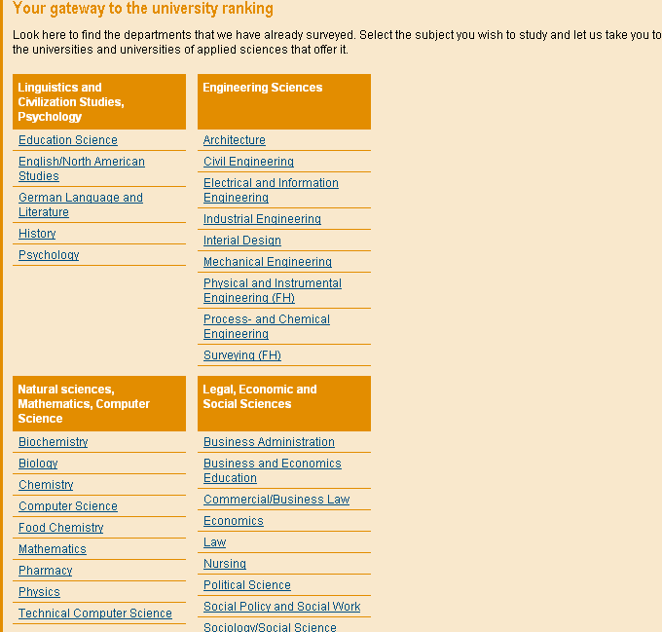
5 CHE-Ranking Principles
No 1
comparison
of
disciplines

Slide 6
1st cycle
2nd cycle
3rd cycle
260 universities
4.000 degree programs
200.000 single data units
1998
business,
chemistry
2002
business, law,
soc. sciences
2005
business, law,
soc. sciences
35 disciplines
1999
law,
sciences.
2003
sciences,
medicine
2006
sciences,
medicine
more than 75 % of all students
2000
engineering.
2004
engineering,
humanities
2007
engineering,
humanities
2001
humanities

Slide 7
5 CHE-Ranking Principles
No 2
time
series

Slide 8
5 CHE-Ranking Principles
No 3
no
league
table
but
rank
groups
top
medium
bottom

Slide 9
5 CHE-Ranking Principles
No 4
no overall
score
but
multi-
dimensional
ranking

Slide 10
5 CHE-Ranking Principles
No 5
inter-
national

Slide 11
Becoming European... Approach 1
D
NL?
FL?
A
CH
CHE-Ranking:
all universities
all subjects
all study programms
Only for some countries
LI?

Slide 12
Becoming European… Approach 2
Segmenting the Market
subject type:
e.g. business
sciences
public or not:
benchmarking
study guide
level of education:
postgraduate programmes

Slide 13
Becoming European… a Pilot Project
EUSID!
European Study Guide
for High Potential Students in Sciences
Aims
contribute to European Higher Education Area
Provide substantial information for Postgraduate Students
show the internationally competitive strength of European science departments!
Method
selection of top-level departments in sciences
multi-dimensional approach
based on the ranking experience of CHE

