Slide 1
Introduction to the CHE University Ranking System
Detlef Müller-Böling
15. September 2006

Slide 2
Initiated by
German Rectors‘ Conference
early 90s
Founding task for CHE

Slide 3
Meta - Ranking 1
„The system used by CHE to evaluate universities is probably the best model available today in the world of higher education.“
Prof. Dr. Francois Tavenas
Rector Emeritus of Université Laval (Quebec)
Founding Rector of Université de Luxembourg
Quality Assurance: A Reference System for Indicators and Evaluation Procedures, Brüssel April 2004

Slide 4
Meta - Ranking 2
„ The German system of institutional ranking is nothing short of brilliant.“
Alex Usher, Vice-President
of the Educational Policy Institute, Canada,
2006

Slide 5
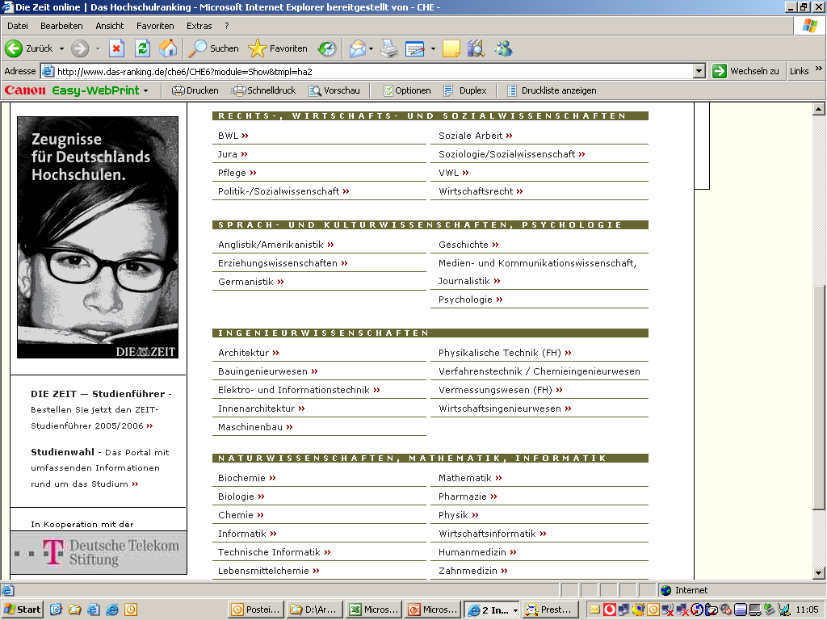
5 Besonderheiten
Nr. 1
Fächer-
vergleiche

Slide 6
1. Zyklus
2. Zyklus
3. Zyklus
280 Hochschulen
4.000 Studienangebote
(inkl. Österreich + Schweiz)
200.000 Einzeldaten
alle drei Jahre aktualisiert
1998
Wirtschaft,
Chemie
2002
Wirtschaft, Jura
Sozialwiss.
2005
Wirtschaft, Jura
Sozialwiss.
36 Studienbereiche
1999
Jura,
Naturwiss.
2003
Naturwiss.,
Medizin
2006
Naturwiss.,
Medizin
2000
Ingenieurwiss.
2004
Ingenieur-,
Geisteswiss..
2007
Ingenieur-,
Geisteswiss..
75 % Studierende
2001
Geisteswiss..

Slide 7
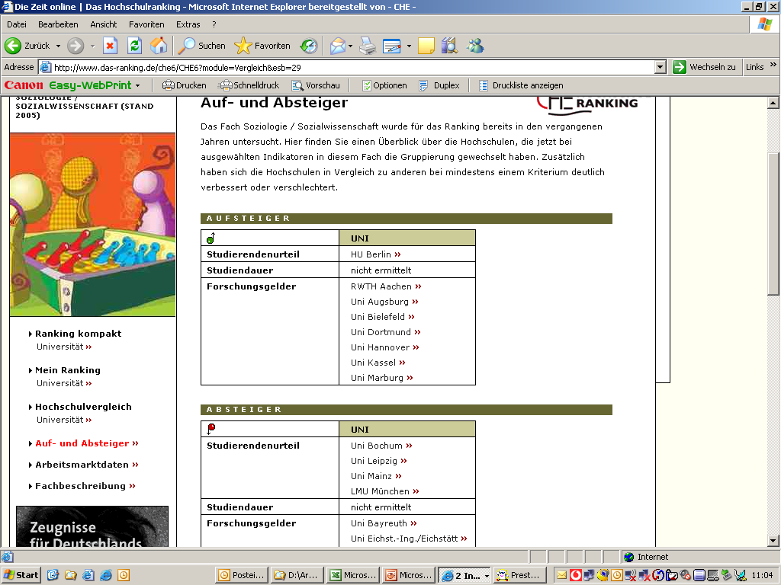
5 Besonderheiten
Nr. 2
Wieder-
holungen
mit
Zeit-
vergleich

Slide 8
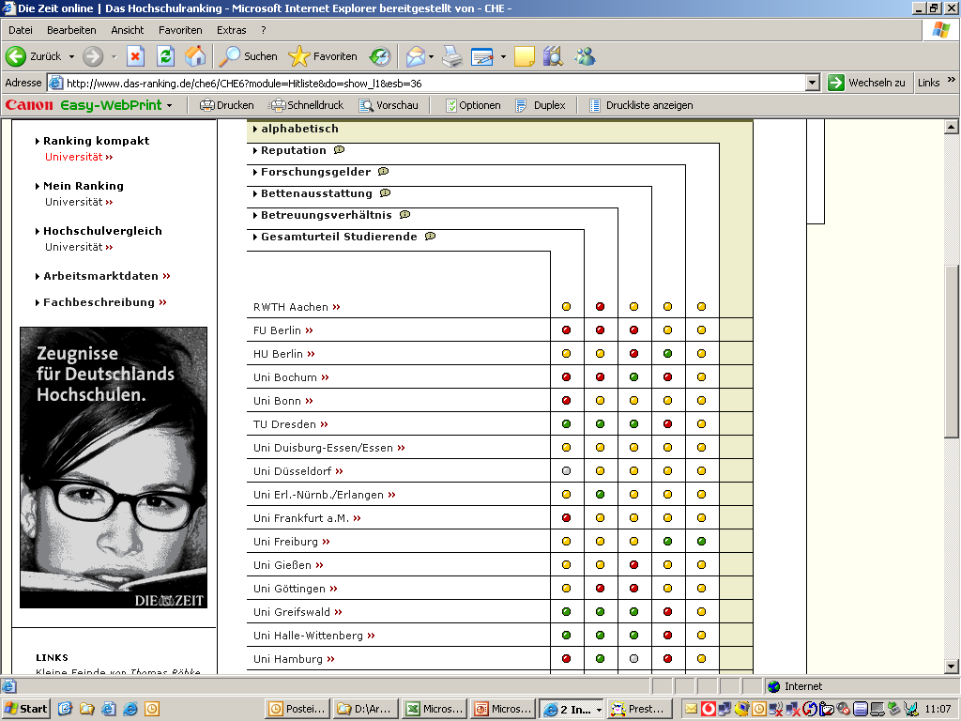
5 Besonderheiten
Spitze
Mittel
Schluss
Nr. 3
keine
Rang-
plätze
nur
Rang-
gruppen

Slide 9
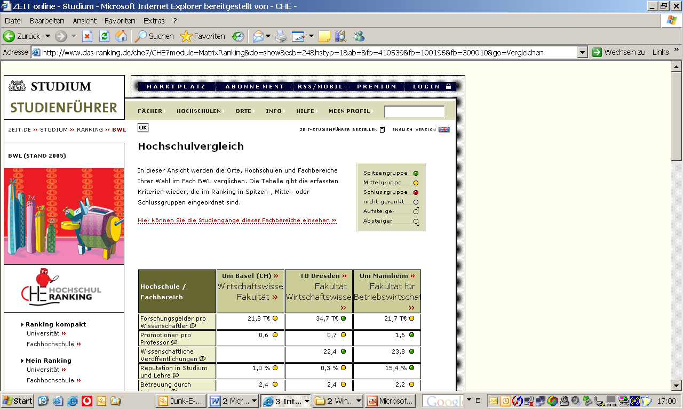
5 Besonderheiten
Nr. 4
Bench-
marking

Slide 10
5 Besonderheiten
Mein Ranking
Nr. 5
keine (gewichteten) Gesamtwerte,
sondern
multidimensionales Ranking

Slide 11
Internationalität

Slide 12
Weltranking „Shanghai“
World Rank | Institution | Total Score | Score on Alumni | Score on Award | Score on HiCi | Score on N&S | Score on SCI | Score on Size
1 | Harvard | 100.0 | 98.6 | 100.0 | 100.0 | 100.0 | 100.0 | 60.6
2 | Stanford | 77.2 | 41.2 | 72.2 | 96.1 | 75.2 | 72.3 | 68.1
3 | Cambridge | 76.2 | 100.0 | 93.4 | 56.6 | 58.5 | 70.2 | 73.2
4 | UC Berkeley | 74.2 | 70.0 | 76.0 | 74.1 | 75.6 | 72.7 | 45.1
5 | MIT | 72.4 | 74.1 | 78.9 | 73.6 | 69.1 | 64.6 | 47.5
45 | TU München | 33.3 | 43.1 | 24.1 | 27.6 | 20.4 | 50.0 | 32.0
51 | LMU München | 32.4 | 37.2 | 21.1 | 12.4 | 32.0 | 56.0 | 31.1
57 | Uni Zürich | 31.1 | 12.6 | 27.3 | 21.4 | 30.3 | 48.9 | 29.9
59 | Uni Kopenhagen | 31.0 | 30.8 | 24.7 | 23.1 | 22.6 | 48.1 | 29.8
64 | Uni Heidelberg | 29.7 | 10.9 | 27.7 | 23.1 | 22.1 | 49.7 | 28.5

Slide 13
Indikatoren des ‚Shanghai-Ranking‘
Nobelpreise seit 1910
Criteria | Indicator | Code | Weight
Quality of Education | Alumni of an institution winning Nobel Prizes and Fields Medals | Alumni | 10%
Quality of Faculty | Staff of an institution winning Nobel Prizes and Fields Medals | Award | 20%
 | Highly cited researchers in 21 broad subject categories | HiCi | 20%
Research Output | Articles published in Nature and Science* | N&S | 20%
 | Articles in Science Citation Index-expanded and Social Science Citation Index | SCI | 20%
Size of Institution | Academic performance with respect to the size of an institution | Size | 10%
Publikationen
* For institutions specialized in humanities and social sciences such as London School of Economics, N&S is not considered, and the weight of N&S is relocated to other indicators.

Slide 14
Becoming European... Approach 1
D
NL
FL
A
CH
CHE-Ranking:
all universities
all subjects
all study programms
Only for some countries
LI?

Slide 15
Becoming European… Approach 2
Segmenting the Market
subject type:
e.g. business
sciences
public or not:
benchmarking
study guide
level of education:
postgraduate programmes

Slide 16
Becoming European… a Pilot Project
EUSID!
European Study Guide
for High Potential Students in Sciences
Aims
contribute to European Higher Education Area
Provide substantial information for Postgraduate Students
show the internationally competitive strength of European science departments!
Method
selection of top-level departments in sciences
multi-dimensional approach
based on the ranking experience of CHE

Slide 17
Communication
recommen-
dations
DIE ZEIT
differentiation
densification
overview
5 indicators; „Studienführer“
all datas + My Ranking
www.che-ranking.de

