Slide 1
Introduction to the CHE University Ranking System
Detlef Müller-Böling
Bern, 28.11.2006

Slide 2
I. Background
Initiated by German Rectors‘ Conference in early 90
Founding task of CHE
First ranking published in 1998
Since then:
extension of number of disciplines/subjects included
since 2002: „Research ranking of German universities“
since 2004: internationalisation
since 2004: Austria
2005/06: Switzerland
2007: pilot project Netherlands /Flanders

Slide 3
II. Internationalisation: Approach 1
D
NL
FL
University C
A
CHE-Ranking:
all universities
(almost) all subjects
all study programmes
Only for some countries
University A
CH
University B
16

Slide 4
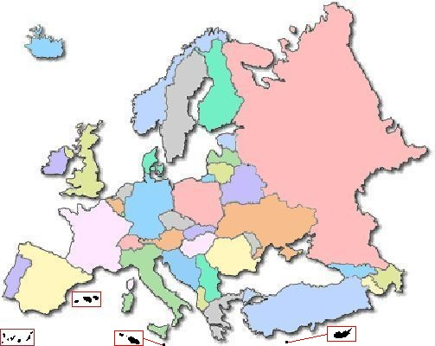
II. Internationalisation: Approach 1: Perspectives
Ranking by types of institutions: European Classification of Higher Education Institutions??
Consortium of regional rankings with comparable methodolgy :
EU Commission: „European Alternative to Shanghai
Ranking“

Slide 5
II. Internationalisation: Approach 2




















Special Rankings, e.g.
Top European Research Universities in Sciences (EUSID)
European MBA Ranking
selective, not each country included !

Slide 6
Meta - Ranking 1
„The system used by CHE to evaluate universities is probably the best model available today in the world of higher education.“
Prof. Dr. Francois Tavenas
Rector Emeritus of Université Laval (Quebec)
Founding Rector of Université de Luxembourg
Quality Assurance: A Reference System for Indicators and Evaluation Procedures, Brüssel April 2004

Slide 7
Meta - Ranking 2
„ The German system of institutional ranking is nothing short of brilliant.“
Alex Usher, Vice-President
of the Educational Policy Institute, Canada,
2006

Slide 8
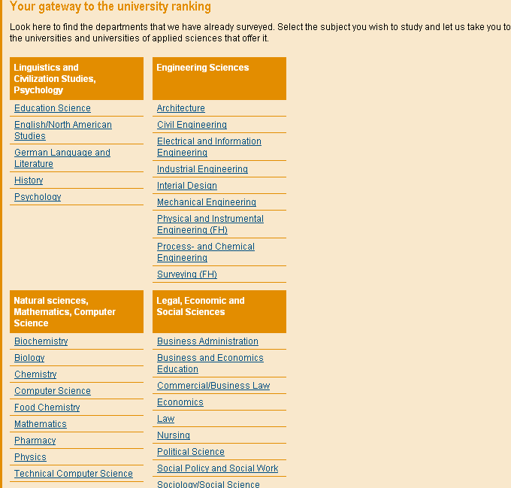
III. CHE-Ranking Principles
No 1
comparison
of
disciplines

Slide 9
1st cycle
2nd cycle
3rd cycle
260 universities
4.000 degree programs
200.000 single data units
1998
business,
chemistry
2002
business, law,
soc. sciences
2005
business, law,
soc. sciences
35 disciplines
1999
law,
sciences.
2003
sciences,
medicine
2006
sciences,
medicine
more than 75 % of all students
2000
engineering.
2004
engineering,
humanities
2007
engineering,
humanities
2001
humanities

Slide 10
III. CHE-Ranking Principles
No 2
no
league
table
but
rank
groups
top
medium
bottom

Slide 11
III. CHE-Ranking Principles
No 3
no overall
score
but
multi-
dimensional
ranking

Slide 12
IV. Approach 2: EUSID
EUSID!
European Study Guide
for High Potential Students in Sciences
Aims
Contribute to European Higher Education Area
Provide substantial information for Postgraduate Students
Show the internationally competitive strength of European science departments

Slide 13
IV. Approach 2: EUSID
Method
basic approach dervied from CHE-ranking (subject ranking, multi-dimensional, rank groups)
selection of European top departments in sciences (physics, chemistry, biology, mathematics)
based on research
20 - 25 departments per discipline
no representation of all countries

Slide 14
IV. Approach 2: possible perspectives
AACSB: Valid European MBA-ranking (alternative to newspaper rankings)
European Association of Law Departments

Slide 15
To sum it up ...
following a strong bottom up approach
focusing on subjects
with a lot of different indicators
which are not weighted
but given as information
for autonomous individuals
to produce their own ranking
we will continue the CHE University Ranking
as well as the CHE Research Ranking
we are establishing EUSID!

