Slide 1
Assessment Exercise in Higher Education
Detlef Müller-Böling
OECD Workshop | Washington, D.C.

Slide 2
Background : Centre for Higher Education Development
Private non-profit organisation
Founded in 1994 by German Rectors‘ Conference & Bertelsmann Foundation
Think tank: Promoting reforms in higher education sector
Consulting projects with HEIs and ministries (e.g. strategy, governance, budgeting, quality management)
Ranking as an instrument of transparency about HE
Staff: 30 persons

Slide 3
Three Approaches
A University Ranking
B Graduate Survey (Alumni Ranking)
C Rating of Promotion of Employability in Bachelor Programs

Slide 4
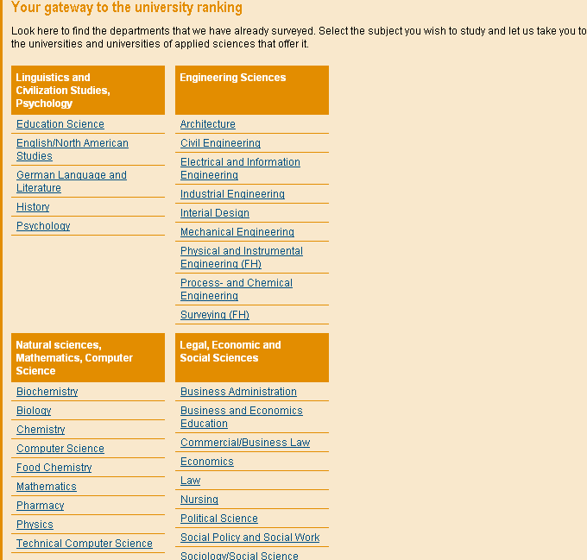
A University Ranking: 3 Principles
No 1
comparison
of
disciplines

Slide 5
A University Ranking: 3 Principles
No 2
no
league
table
but
rank
groups
top
medium
bottom

Slide 6
A University Ranking: 3 Principles
No 3
no overall
score
but
multi-
dimensional
ranking

Slide 7
Meta - Ranking 1
„The system used by CHE to evaluate universities is probably the best model available today in the world of higher education.“
Prof. Dr. Francois Tavenas
Rector Emeritus of Université Laval (Quebec)
Founding Rector of Université de Luxembourg
Quality Assurance: A Reference System for Indicators and Evaluation Procedures, Brüssel April 2004

Slide 8
Meta - Ranking 2
„ The German system of institutional ranking is nothing short of brilliant.“
Alex Usher, Vice-President
of the Educational Policy Institute, Canada,
2006

Slide 9
A University Ranking
Internationalizing
Universities from other European Countries joined CHE-Ranking:
2004: Austria
2005: Switzerland
2007: Netherlands /Flanders

Slide 10
A University Ranking
Top-Level-Ranking „CHEmpions-League-Ranking“
basic approach dervied from CHE-ranking (subject ranking, multi-dimensional, rank groups)
selection of European top departments in sciences (physics, chemistry, biology, mathematics)
based on research
20 - 25 departments per discipline
no representation of all countries

Slide 11
B Graduate Survey
graduate competencies
named CHE-Alumni-Ranking
graduates assess
the qualifications on the background of their work experiences
the former learning environments
the labour market careers
Self-Assessment

Slide 12
C Rating Promotion of Employability
Employability is different from actual employment
Employability relates to the capabilities of persons, not to higher education institutions
Institutions can provide employability development opportunities
they are the focus of the study

Slide 13
C Rating Promotion of Employability
Employability
Methodological competences
Social competences
Disciplinary
competences
profile
Work experience
Internationality

Slide 14
C Rating Employability: Methodological competencies
 | competences | points
1 | Obligatory (core) credits for IT skills media comepetences information seeking project-/time-management case studies, simulations | 5
2 | More than 6 obligatory credits for those aspects | 5
3 | Additional credits (electives) in at least 2 aspects | 2
4 | Number of credits for presentations > 20 Number of credits between 10 - 20 | 2 (1)
5 | credits Bachelor thesis 10 - 20 | 2
 | maximum | 16

Slide 15
C Rating Employability: Social skills
 | Competences/skills | points
1 | Obligatory (core) credits for team work business plans techniques of negociation | 3
2 | More than 6 obligatory credits for those aspects | 3
3 | Additional credits (electives) in at least 1 aspect | 1
4 | Strcutured activities regarding entrepreneurship | 2 (1)
5 | Possibility of credits for tutorial activites | 1
 | maximum | 10

Slide 16
C Rating Employability: Work experience
 | Competences/skills | points
1 | compulsory practice phase(s) at least 12 weeks or 18 credits | 2 1
2 | Professors/lecturers with work experience outside HE at least 10 % (universities) resp. 65 % (Fachhochschulen) | 1
3 | Percentage of courses offered by external practioners at least 10 % (universities) resp. 20 % (Fachhochschulen) | 1
4 | Information on labour market, career opportunities: 8 hors per semester | 1
5 | Existence of career center, business advisory board, Praktikumsbörse | 3
 | maximum | 10

Slide 17
C Rating Employability: Internationality
 | Aspects | points
1 | compulsory study phase abroad If not: > 75 % of students with int. exchange > 30 % of students with int. exchange | 2 (2) (1)
2 | compulsory work experience phase abroad If not: > 75 % of students with int. exchange > 30 % of students with int. exchange | 1 (1) (0,5)
3 | foreign students > 10 % | 1
4 | Core credits for foreign languages > 10 | 1
5 | courses in foreign language > 15 % | 1
6 | Bachelor thesis in foreign language possible | 1
7 | Professors appointed from abroad | 1
 | maximum | 8

