Slide 1
CHE UniversityRanking History, Approach, Internationalizing
Detlef Müller-Böling
Meeting of Directors General European Union, | Berlin

Slide 2
Agenda
Background and History
CHE Ranking Approach
Internationalizing CHE Ranking

Slide 3
Background and History
Initiated by German Rectors‘ Conference and Bertelsmann Foundation
Ranking: Founding task of CHE
Publishing cooperated with

Slide 4
Communication
CHE is responsible for all content
DIE ZEIT is responsible in preparing informations for the young target group
economic and methodological interest are thus seperated

Slide 5
Communication
recommen-
dations
DIE ZEIT
differentiation
densification
overview
5 indicators; „Studienführer“
all datas + My Ranking
www.che-ranking.de

Slide 6
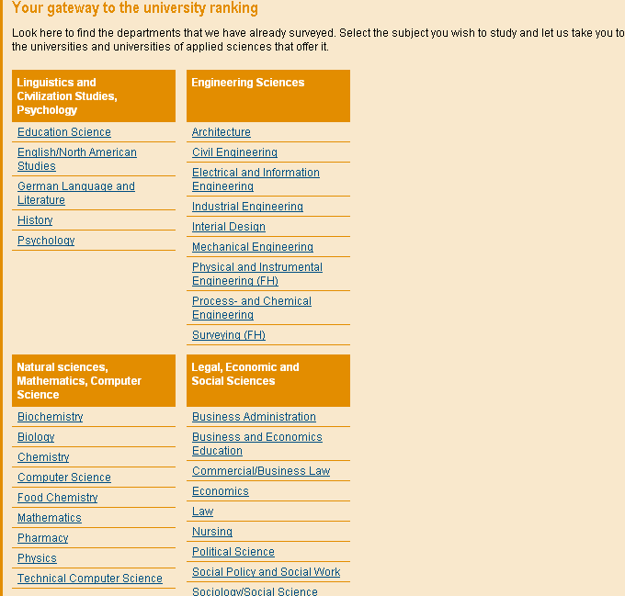
CHE-Ranking Principles
No 1
comparison
of
disciplines

Slide 7
1st cycle
2nd cycle
3rd cycle
281 universities
2,490 departments
6,380 degree programs
+ 200,000 single data units
1998
business,
chemistry
2002
business, law,
soc. sciences
2005
business, law,
soc. sciences
35 disciplines
1999
law,
sciences.
2003
sciences,
medicine
2006
sciences,
medicine
more than 75 % of all students
2000
engineering.
2004
engineering,
humanities
2007
engineering,
humanities
2001
humanities

Slide 8
CHE-Ranking Principles
No 2
no
league
table
but
rank
groups
top
medium
bottom

Slide 9
CHE-Ranking Principles
No 3
no overall
score
but
multi-
dimensional
ranking

Slide 10
Meta - Ranking 1
„The system used by CHE to evaluate universities is probably the best model available today in the world of higher education.“
Prof. Dr. Francois Tavenas
Rector Emeritus of Université Laval (Quebec)
Founding Rector of Université de Luxembourg
Quality Assurance: A Reference System for Indicators and Evaluation Procedures, Brüssel April 2004

Slide 11
Meta - Ranking 2
„ The German system of institutional ranking is nothing short of brilliant.“
Alex Usher, Vice-President
of the Educational Policy Institute, Canada,
2006

Slide 12
Internationalisation: Approach 1
D
NL
FL
University C
A
University A
CH
University B
16

Slide 13
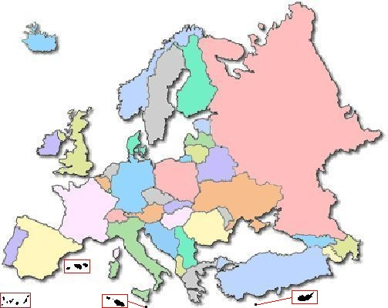
Approach 1: Regional crossborder

Slide 14
Approach 2: Cluster
























Slide 15
mpions League Ranking
Biology
25 departments
Chemistry
25 departments
Physics
24 departments
Mathematics
19 departments

Slide 16
mpions League Ranking
33 Universities
1 department
15 Universities
2 departments
4 Universities
3 departments
4 Universities
4 departments

Slide 17
To sum it up ...
chose a strong bottom up approach
focusing on subjects
present a lot of different indicators
which are not weighted
There is a better approach than so called World Rankings.
given as information
for autonomous individuals
to produce their own ranking
make your methodlogy transparent

