Slide 1
The CHE- / stern - ranking
Detlef Müller-Böling
CHE Centre for Higher Education Development
Gütersloh, Germany
How well do reforms travel?
CIES Symposium
12. March 2003
New Orleans

Slide 2
Initiated by German Rectors‘ Conference
early 90s
Founding task for CHE

Slide 3
Gerhard Casper - Stanford:
Ranking of
universities as entities
not justified
Ranking of
single subjects / subject
areas
Aggregation
of research & teaching
wrong
Multidimensional
ranking
No individual ranks in
league tables,
but „Michelin stars“
Rank groups
top intermediate
bottom

Slide 4
Facts - up to now
241 universities
> 2.000 departments and programmes
> 140.000 students,
approx. 15.000 professors
25 subject areas
completely free access: www.dashochschulranking.de

Slide 5
Communication
recommen-
dations
(stern)
differentiation
densification
overview
( 5 indicators; „stern spezial“)
all datas + personal ranking
(Internet)

Slide 6
Indicators: Decision model
city,
university
students
Study
outcome
Internatio-
nalisation
teaching
ressources
research
labour market,
employability
Overall
assessment
(students,
professors)
Each components contains several indicators
Notes:
1. Fächer zeigen Maschinenbau einsteigen
2. Anhand von Bremen die 30 Indikatoren zeigen
3. Hitliste aufrufen

Slide 7
Indicators: multiperspectivity
... from different data sources
research
publications /citations (bibliometric analysis)
research funding (faculties/departments)
research reputation (professors survey)

Slide 8
Indicators: multiperspectivity
... facts as well as judgements
teaching
staff-students-ratio (fact)
judgement on course organisation
(students & professors)
judgement on contact between students
and professors (students & professors)

Slide 9
Quality assurance:
Plausibilty checks
Advisory board
Statistical checks
Policy:
Better publish no data than bad data !

Slide 10
Effects: page-impressions

Slide 11
Effects: individual level
Students
> 1/3 use rankings for orientation
50 % engineers
42 % business students
36 % law students
19 % literature
mainly achievement-oriented

Slide 12
Effects: example
Psychology
numbers of applications at recommended universities
+ 19,4 % „researcher“
+ 15,1 % „straight ones“

Slide 13
Effects: institutional level
Universities
Analysis of strengths/weaknesses
Examples of reforms/ reorganisations

Slide 14
Perspective
Austria + Switzerland
Austrian Universities decided
to join the CHE-Ranking.
SwissUp is using our methology.
We will combine the datas.

Slide 15
The CHE- / stern - ranking
Detlef Müller-Böling
CHE Centre for Higher Education Development
Gütersloh, Germany
How well do reforms travel?
CIEMS Symposium
12. March 2003
New Orleans

Slide 16
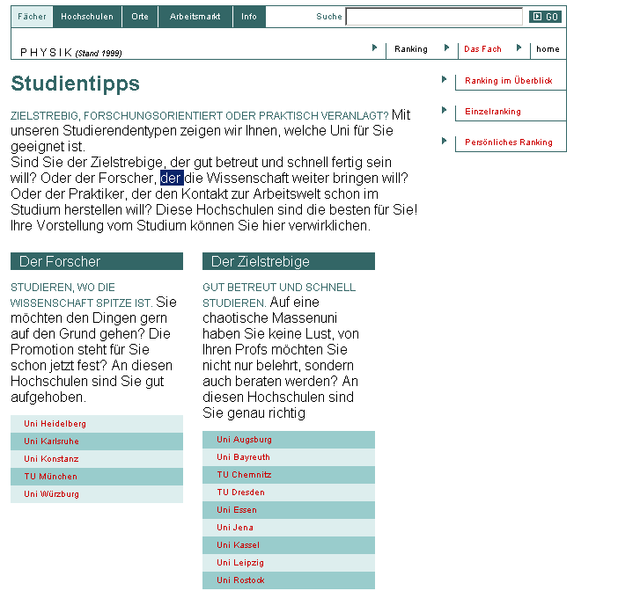
Studientipps

Slide 17
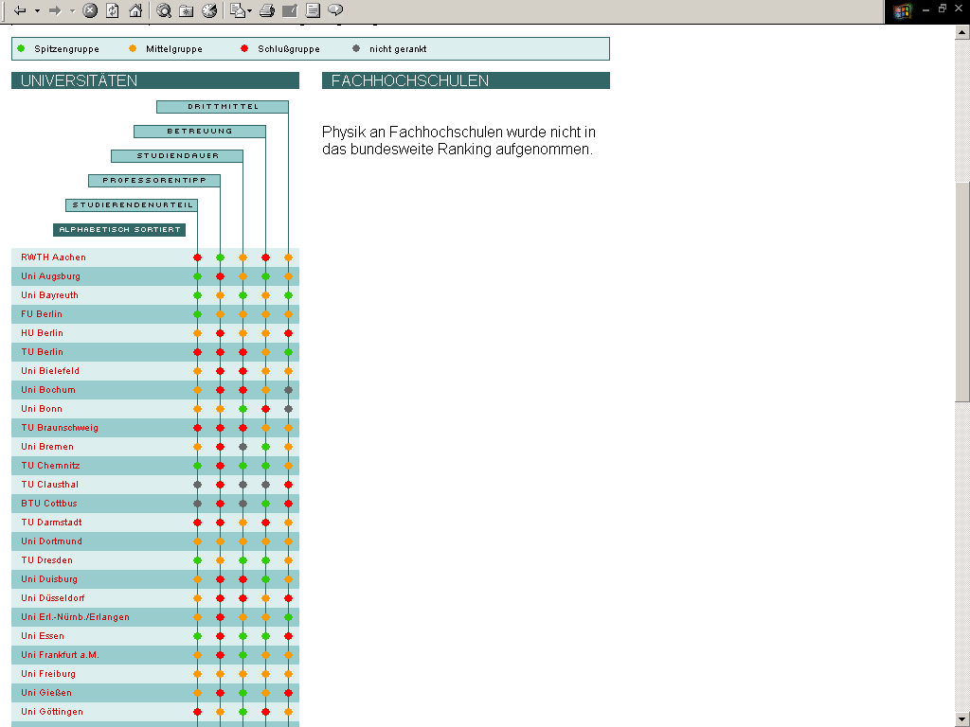
Hitlisten

Slide 18
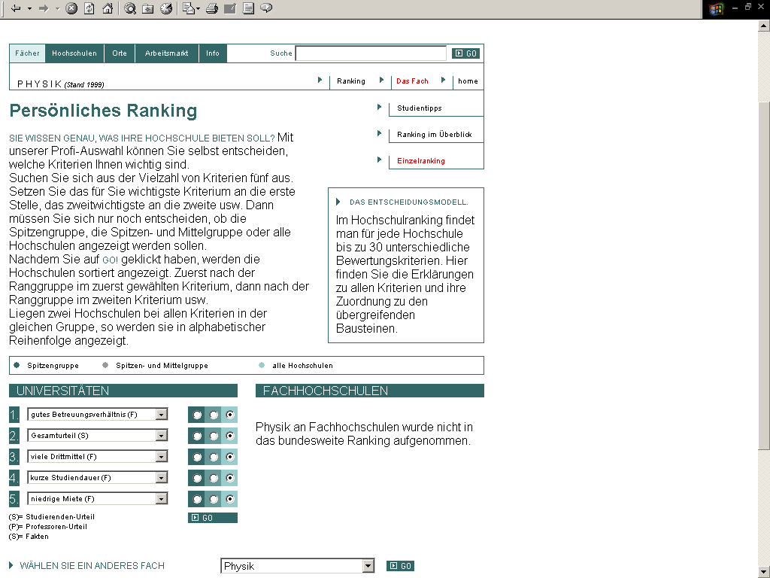
Persönliches Ranking

Slide 19
Persönliches Ranking

Slide 20
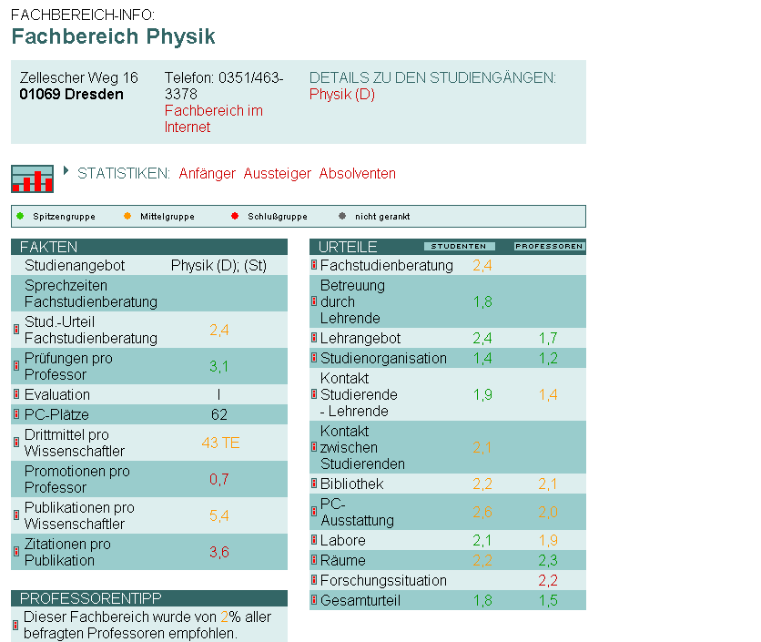
Detailinformationen

Slide 21
Detailinformationen

Slide 22
Orientation towards target group(s)
Heterogeneity of preferences for decision within target group
no overall score
interactive selection & weighting of indicators
Identification of relevant criteria / indicators
by expert group
by group discussions with school leavers & students

Slide 23
Rank groups: procedure
Groups instead of league table position avoid
misinterpretation of differences in indicators
2 different procedures of group ranking:
1. Facts
ordering according to quartiles
correction in case of characteristic jumps

Slide 24
Rank groups: procedure
2. Judgements (students, professors)
top group if confidence interval of mean is below overall mean
bottom group if confidence interval of mean is above overall mean
middle group
either if mean is intermediate
or if dispersion is high, i.e. confidence interval is neither completely below nor above the overall mean

Slide 25
4. The role of the universities
Ranking born out of project of German Rectors’
Conference on “Profile development”
Acceptance of ranking by universities has high priority
Co-operation of universities is essential

