Slide 1
CHE-Ranking Methodology and Presentation
Prof. Dr. Detlef Müller-Böling
Gero Federkeil
CHE Center for Higher Education Development
Germany
Hoger onderwijs ranking in Euopees perspectief,
het CHE-systeem
CHEPS-seminar, 2 december 2005, Amersfoort

Slide 2
Initiated by German Rectors‘ Conference
early 90s
Founding task for CHE

Slide 3
„The system used by CHE to evaluate universities is probably the best model available today in the world of higher education.“
Prof. Dr. Francois Tavenas
Rector Emeritus of Université Laval (Quebec)
Founding Rector of Université de Luxembourg
Quality Assurance: A Reference System for Indicators and Evaluation Procedures, Brüssel April 2004

Slide 4
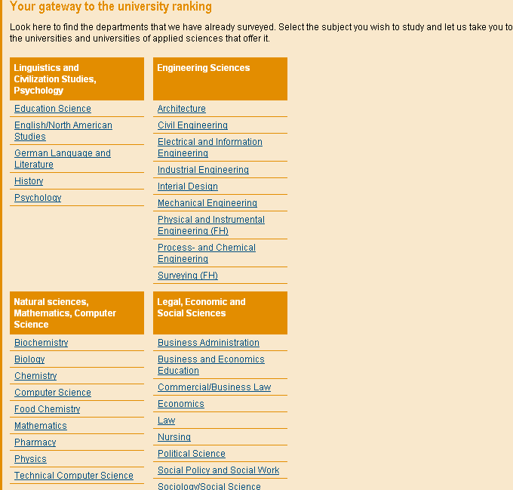
5 CHE-Ranking Principles
No 1
comparison
of
disciplines

Slide 5
1st cycle
2nd cycle
3rd cycle
260 universities
4.000 degree programs
200.000 single data
1998
business,
chemistry
2002
business, law,
soc. sciences
2005
business, law,
soc. sciences
35 disciplines
1999
law,
sciences.
2003
sciences,
medicine
2006
sciences,
medicine
more than 75 % of all students
2000
engineering.
2004
engeneering,
humanities
2007
engineering,
humanities
2001
humanities

Slide 6
5 CHE-Ranking Principles
No 2
time
series

Slide 7
5 CHE-Ranking Principles
No 3
no
league
table
but
rank
groups
top
medium
bottom

Slide 8
5 CHE-Ranking Principles
No 4
no overall
score
but
multi-
dimensional
ranking

Slide 9
5 CHE-Ranking Principles
No 5
inter-
national

Slide 10
Internationalisation
Principles
High acceptance
Taking into account specific
Characteristics of HE System

Slide 11
Internationalisation
first step: Switzerland and Austria
2002/03: start with pilot project Austria:
mathematics, chemistry - unpublished
2003/04: project Austria – published rsults:
electrical engineering, English studies
2004/05: wSwtzerland & Austria: law, business studies, economics, sociology , political sciences

Slide 12
Internationalisation
first step: Switzerland and Austria
perspective: other European countries
following principles:
discipline by discipline
multidimensional
rank groups

Slide 13
Communication
recommen-
dations
DIE ZEIT
differentiation
densification
overview
5 indicators; „Studienführer“
all datas + My Ranking
www.che-ranking.de

Slide 14
Page Impressions Internet

Slide 15
Page Impressions per day
DAAD-Mail September 2005:
„Im August hatten wir 5.879 Seitenzugriffe pro Tag auf das Ranking, dies sind ca. 15% unserer gesamten Zugriffe im Bereich ‚Info für Ausländer‘, ein sehr guter Wert!
Im August war das Ranking sogar beliebter als die DAAD-Stipendiendatenbank.“

Slide 16
Effects: Individual level
First year students 2004/05
63 % use rankings for information
48 % say rankings are useful information
50 % know CHE-Ranking

Slide 17
Effects: Individual level
First year students
good ranking results are important in chosing a university
28 % in humanities
29 % in econ., soc. sciences
38 % in engineering
39 % in sciences
42 % in law & medicine

Slide 18
Effects: example
Psychology, Medicine
growing numbers of applications at universities with good ranking results
higher impact of good than of bad results

Slide 19
Effects: institutional level
Universities
Analysis of strengths/weaknesses
Examples of reforms/ reorganisations

Slide 20
Example: Details from the student survey
Number of requests for detailed results of the student survey
Departments, Universities for internal analysis Groups of Universities for benchmarking

Slide 21
Example: University of Bielefeld
Physik
Chemie
35
25
30
20
25
15
20
15
10
10
5
5
0
0
Uni Bielefeld
Uni Freiburg
Uni Göttingen
Uni Konstanz
Uni Münster
Uni Paderborn
Uni Bielefeld
Uni Freiburg
Uni Göttingen
Uni Konstanz
Uni Münster
Uni Paderborn
(c) CHE
(c) CHE
Biologie
Psychologie
12
8
10
7
8
6
5
6
4
4
3
2
2
1
0
0
Uni Bielefeld
Uni Freiburg
Uni Göttingen
Uni Konstanz
Uni Münster
Uni Bielefeld
Uni Freiburg
Uni Göttingen
Uni Konstanz
Uni Münster
(c) CHE
(c) CHE

Slide 22
Studierendenurteile: Soziologie
© CHE

Slide 23
Effects: Institutional level
Universities (DAAD-Survey 2005)
increasing nationwide student applicants
increasing number of first-year students
increasing third-party funds
good arguments in the internal discussion about resources (http://www.gate-germany.de/6.3.9.7.html)

Slide 24
Effects: Institutional level
DAAD Survey 2005
at international level good rankings are important for the cooperation with external universities
DAAD will intensify the use of the CHE-Ranking in its marketing activities

Slide 25
Effects: labor market
Staff Manager / Recruiter / Headhunter
Choice of universities for personnel recruitment
aus: UniMagazin 7/2005: Erfolgreiche Suche nach den Besten? – oder wie beurteilen Personaler Hochschulrankings

Slide 26
Effects: labor market
„Während der Mittelstand sie offenbar eher zögerlich angeht, scheinen größere Konzerne sie häufiger als mögliche Entscheidungshilfe in die Personalauswahl einzubeziehen.“ (UniMagazin 7/2005).
„Überdurchschnittlich viele Bewerber kommen von Universitäten mit wissenschaftlicher Ausbildung auf hohem Niveau und internationaler Vernetzung. Insofern bestätigen die Ergebnisse von Rankings immer wieder unsere Recruiting-Praxis“
(Jost Schürmann, Boston Consulting Group“)

Slide 27
Indicators
city,
university
students
study
outcome
internatio-
nalisation
teaching
ressources
research
labour market,
employability
overall
assessment
(students,
professors)
Each component comprises several indicators…, 35 in sum
Notes:
1. Fächer zeigen Maschinenbau einsteigen
2. Anhand von Bremen die 30 Indikatoren zeigen
3. Hitliste aufrufen

Slide 28
Indicators: multi-perspectivity
... from different data sources…
research
publications /citations
(bibliometric analysis)
research grants
(faculties/departments)
research reputation
(professors survey)

Slide 29
Indicators: multi-perspectivity
... facts as well as judgements
teaching
staff-students-ratio (fact)
student assessment of contact
between students and professors
student assessment of course
organisation

Slide 30
Method of grouping I
Different methods for
facts and
student judgements
a) facts
Method: quartile distribution,
i.e.: the best 25% belong to top group
the worst 25 % belong to bottom group
and the intermediate 50 % to middle group

Slide 31
Methods of grouping II
b) Students‘ judgements:
taking into account
the mean for a university
the number of cases at a university and
the homogentiy/diversity within a university
i.e. a university is ranked top, if
the confidence interval of a university is completely
better than the overall mean of a discipline
a university is ranked into the bottom group, if
the confidence interval of a university is completely
worse than the overall mean of a discipline

Slide 32
Methods of grouping II
Univ.1
Univ. 2
Univ. 3
Univ.4
1
mean univ. 1
conf.
interval
overall mean
6

